Slide 1
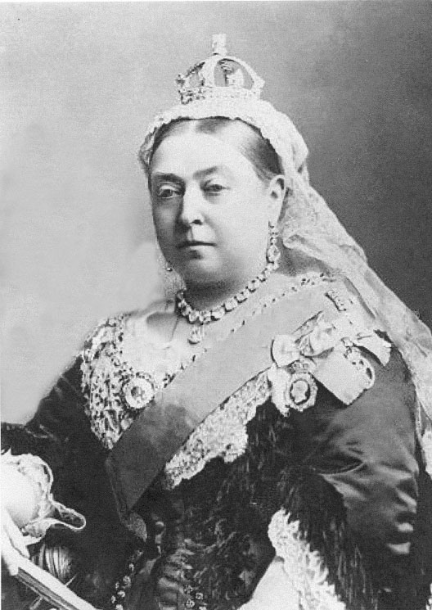
Imperialism
Warm Up – Define the following:
Imperialism
Capitalism
Nationalism
Queen Victoria

Slide 2
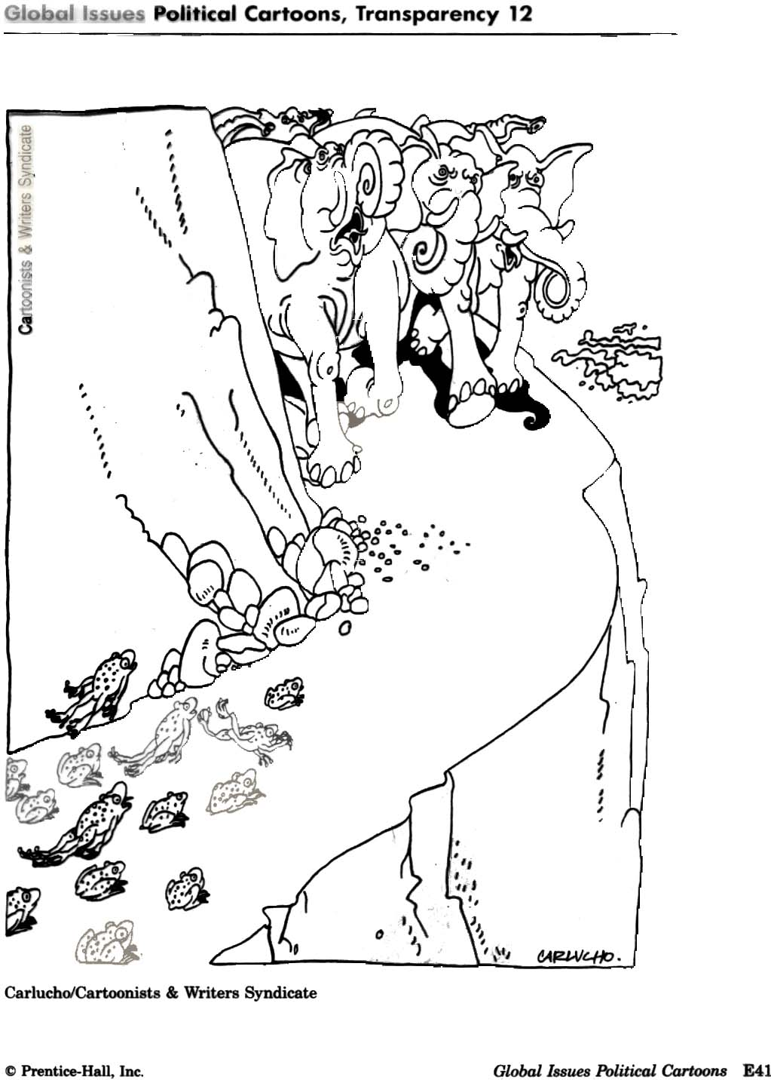
Imperialism or Nationalism?
Issue: decide whether the picture depicts imperialism or nationalism and tell why you chose as you did.

Slide 3
1. Imperialism – When a strong nation dominates other countries socially, economically & politically
“Conquering foreign lands”
Example: Atlantic Slave Trade
Issue: How is the Atlantic Slave Trade an example of Imperialism?

Slide 4
2. Capitalism – Economic system in which the means of production are privately owned and operated for profit
“Individual ownership of business & property, geared towards profit”
Issue: What is 1 positive feature & 1 negative feature of Capitalism?

Slide 5
3. Nationalism – The belief that people should be loyal mainly to their nation.
“A sense of identity & unity with the people in your country.”
Issue: Is Nationalism necessary for a healthy nation? How can Nationalism be a problem?

Slide 6
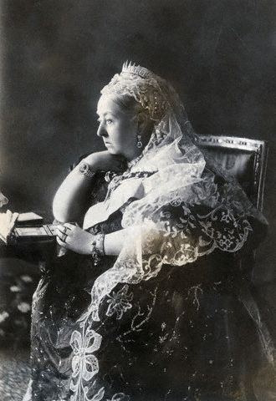
Why Imperialism?
Empire Building
Economics
Political and Military Interests
Power and Authority
Nineteenth Century – 1800s
British Dominance - called the Victorian Era after Queen Victoria who ruled for 64 years

Slide 7
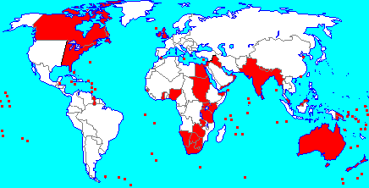
The Sun Never Sets on the British Empire
What does this quote mean?
<Look at the map>

Slide 8
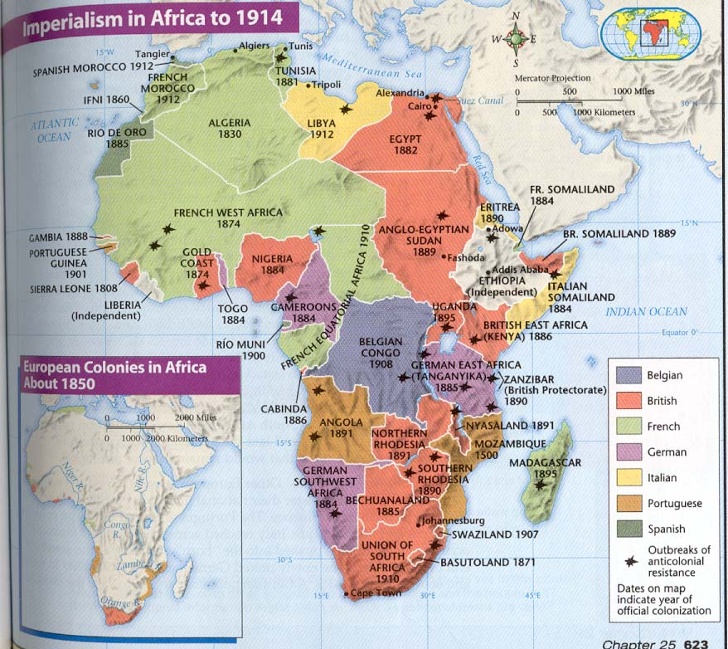
Imperialism and Empire - Africa
1880 – Most of Africa consisted of independent states
1914 – With the exception of Ethiopia and Liberia, all of Africa was controlled by Europeans

Slide 9
Forces Enabling African and Indian Imperialism
European technological superiority
  Steamboats
  Automatic machine gun
  Locomotive
  Telegraph
Europeans had the means to control their empires
  Easy travel
  Wide spread communication
African and Indian disunity
  Huge variety of cultures
  Fighting among cultures
  Huge business interests and support from companies

Slide 10
British in India
British East India company controlled much of India using sepoys.
Sepoys – Native Hindu or Muslim mercenary private police
Crops: opium poppies for sale in China and cotton and tea for sale in the rest of the British empire
Cotton textile making outlawed in India
The Raj “British Rule” was so profitable, it was called the “Jewel in the Crown.”

Slide 11
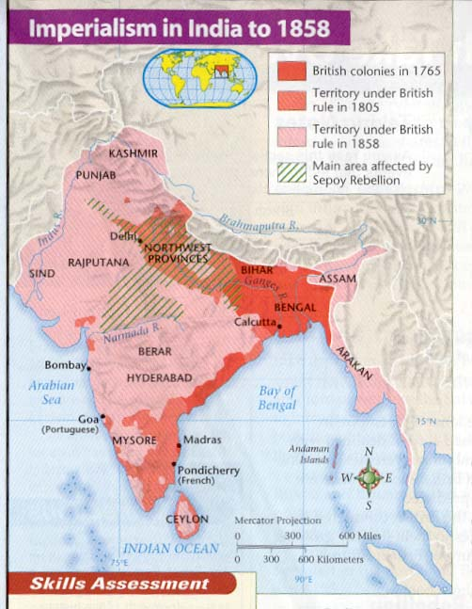
Imperialism and Empire - India
The Sepoy Rebellion allowed British soldiers to invade and control all of India
The British established control of India and its neighbors by 1914.
The British controlled Australia, New Zealand and much of the far east. The worlds’ biggest empire!

Slide 12
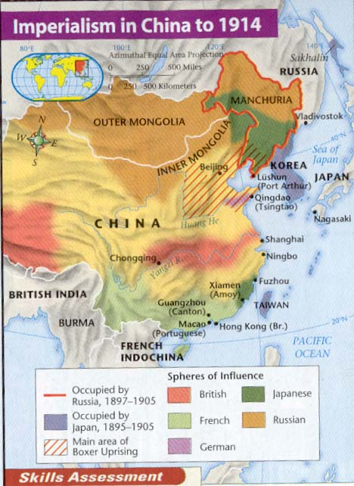
Imperialism in China
Because of repeated attempts at invasion, China distrusted foreigners and tried to remain isolationist.
China felt that other nations were barbaric compared to China
They restricted Europeans to trade in one city (Guangzhou).
Britain gained spheres of influence in China through smuggling opium. Resulted in Opium War and Boxer Rebellion.

Slide 13
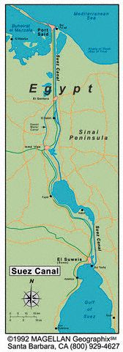
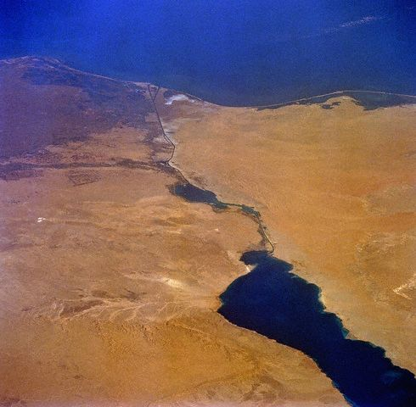
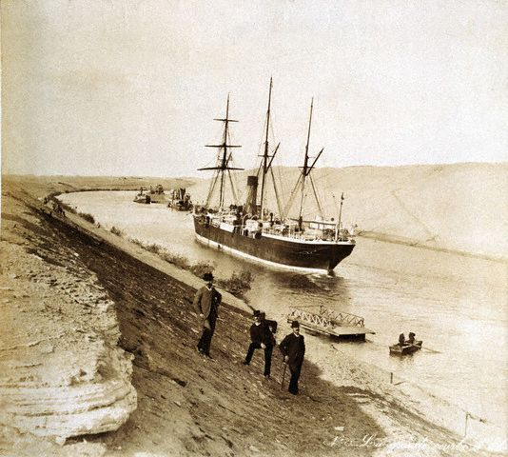
Suez Canal - 1875
Europeans needed a faster way to get from the Mediterranean to the Indian Ocean
The French and the Egyptians, with funding from France, began a canal to connect the two water bodies.
Because Egypt could not pay their canal debts, they sold their shares to Great Britain
1882 – Egyptian nationalists rebel against foreign influence. British make Egypt a protectorate and take over control of the canal.

Slide 14
Imperialism in America
Early imperialism called Manifest Destiny – to expand from “sea to shining sea.” Indian wars, the Mexican War and the Civil War have been called examples of such imperialism.
Americans moved out into the Pacific Ocean in the nineteenth century (1800s). Took control of Hawaii through threat of force.
Japan – in 1853 Commodore Matthew Perry opened up trade with Japan by threatening military action.
Japanese opened up trade to everyone. By 1830, Japan itself was an imperialist power, taking control of the Pacific.
Fought a war with Spain in 1898. Acquired the Philippines, Guam and Puerto Rico. (Spanish American War)

Slide 15
The Age of Imperialism, 1850-1914
Causes
Nationalism
To gain power, European nations compete for colonies and trade.
Imperialism
Economic Competition
Europeans
exerted influence over the economic, political, and social lives of people they colonized.
Demand for raw materials and new markets spurs a search for colonies.
Missionary Spirit
Europeans believe they must spread their Christian teachings to the world.

Slide 16
The Age of Imperialism, 1850-1914
Effects
Colonization
Europeans control land and people in areas of Africa, Asia, and Latin America.
Imperialism
Europeans
exerted influence over the economic, political, and social lives of people they colonized.
Colonial Economics
Europeans control trade in the colonies and set up dependent cash-crop economies.
Christianization
Christianity is spread to Africa, India, and Asia.

Slide 17
Causes of Imperialism
S – Population growth; new knowledge (technology)
P – Competition between gov’t in Europe; spheres of influence
I – New Weapons; Need for “bases”
C – Racial Superiority; White Man’s Burden
E – Raw Materials, new markets for goods

Slide 18
Effects of Imperialism
S – Continued population growth for Europeans; race implies social class
P – British Empire (largest ever); European gov’t ideals spread;
I – Wars for land/resources;
C – Spread of European culture, art, language
E – European wealth; dependent nations suffer

Slide 19
Questions
1. How did European imperialism improve peoples’ lives?
2. How did European imperialism harm peoples’ lives?
3. What is an example of economic imperialism?
4. What is the most successful imperialist nation during this period? What allowed them to be so successful (be specific)?
5. What does the term “Sphere of Influence” mean? Where & How does America have a “Sphere of Influence” today?
6. Explain the Sepoy Rebellion & how it led to Britain gaining direct control of India
7. Why did the Chinese restrict trade with Europe to one city?
8. What is the term for British Rule in India?
9. How did the Industrial Revolution give Europeans an edge over other cultures?
10. Why did European Nations “Scramble for Africa” in the 19th century?

